Slide 1
Impact San Antonio empowers women to make the most of their charitable donations to impact the Greater San Antonio community and the nonprofits they serve.

Slide 2
Welcome and Introductions Impact San Antonio 2017 Agency Training Beverley McClure – President Cynthia Schluter – Vice President
Cathy Foose and Kim Gilbert
Agencies and Applications Co-Chairs
Donna Harrison
Grant review co-chair
Kerry Quinn
Treasurer – Financial Review Chair
Peggy Vroman Gracy
Grant Oversight and Outcomes Chair

Slide 3
Agency Training - 2017
TOPIC | PRESENTER(S)
Welcome | Beverley McClure Cynthia Schluter
What’s New? | Cathy Foose
Foundant System Overview | Donna Harrison
Writing an Impactful Application | Cathy Foose
Financial Review | Kerry Quinn
Grant Review & Selection Process | Donna Harrison
Strengthening Your Application | Kim Gilbert
Oversight and Outcomes | Peggy Vroman-Gracy
Lessons Learned Alpha Home – 2016 Grant Award | Angela White – CEO Alpha Home
Wrap-up & Q & A | Impact Team

Slide 4
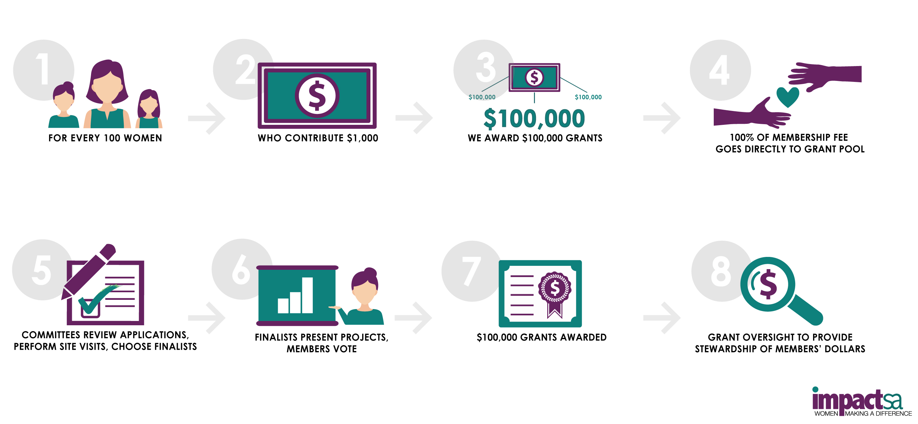
How Does Impact SA Work?

Slide 5
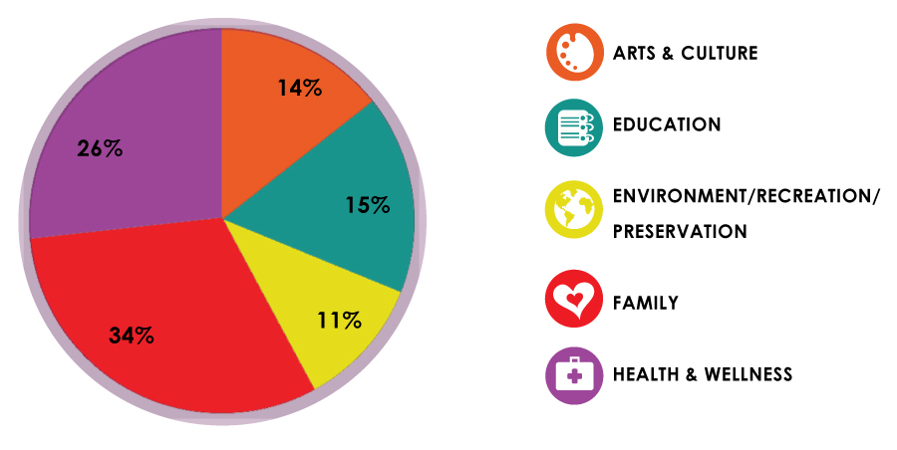
Over $2.2 Million Since Inception

Slide 6
Five $100,000 Grants through the strength of 500 Members
One in each of our five focus areas:
Arts and Culture
Education
Environment, Recreation, Preservation
Family
Health and Wellness
More members = more grants = greater impact

Slide 7
What’s New?
Simplified application process
New Grant Management Software
Willingness to continue to partner with ISA on outcomes for two years post grant.
Markers of a High Impact Grant

Slide 8
Our New Application Site - It’s as easy as 1, 2, 3
1. Visit the Impact San Antonio application website.
We will email the link to all of our agency contacts shortly before the application window opens. You can also link via the Impact SA website.
https://www.grantinterface.com/Common/LogOn.aspx?urlkey=impactsan
2. Create an account.
3. Complete the online application and submit before the deadline.

Slide 9
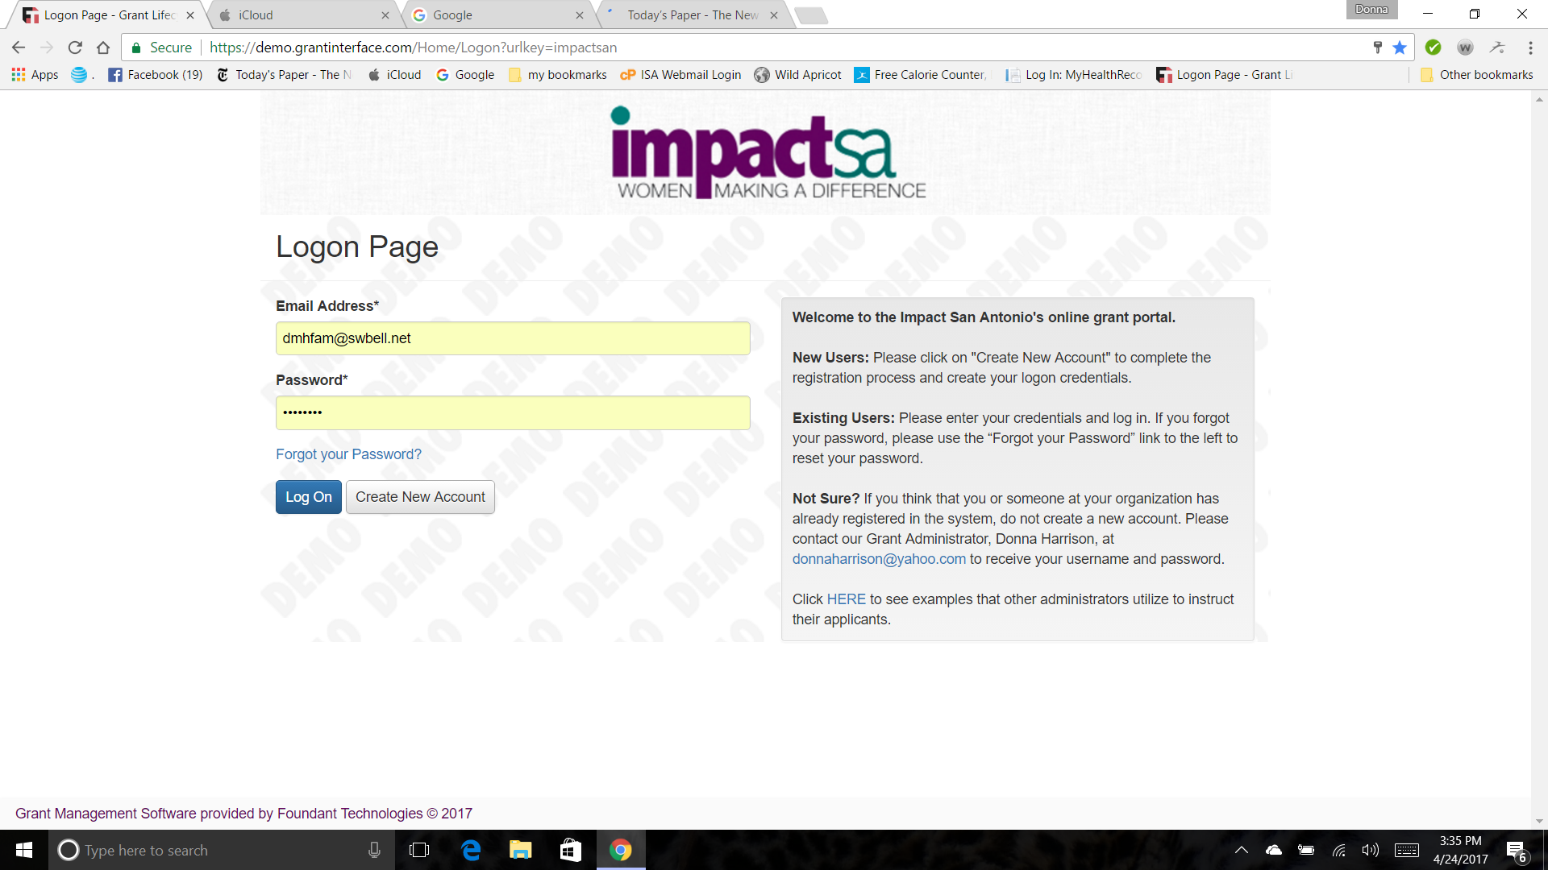
Create an account the first time you visit our application portal

Slide 10
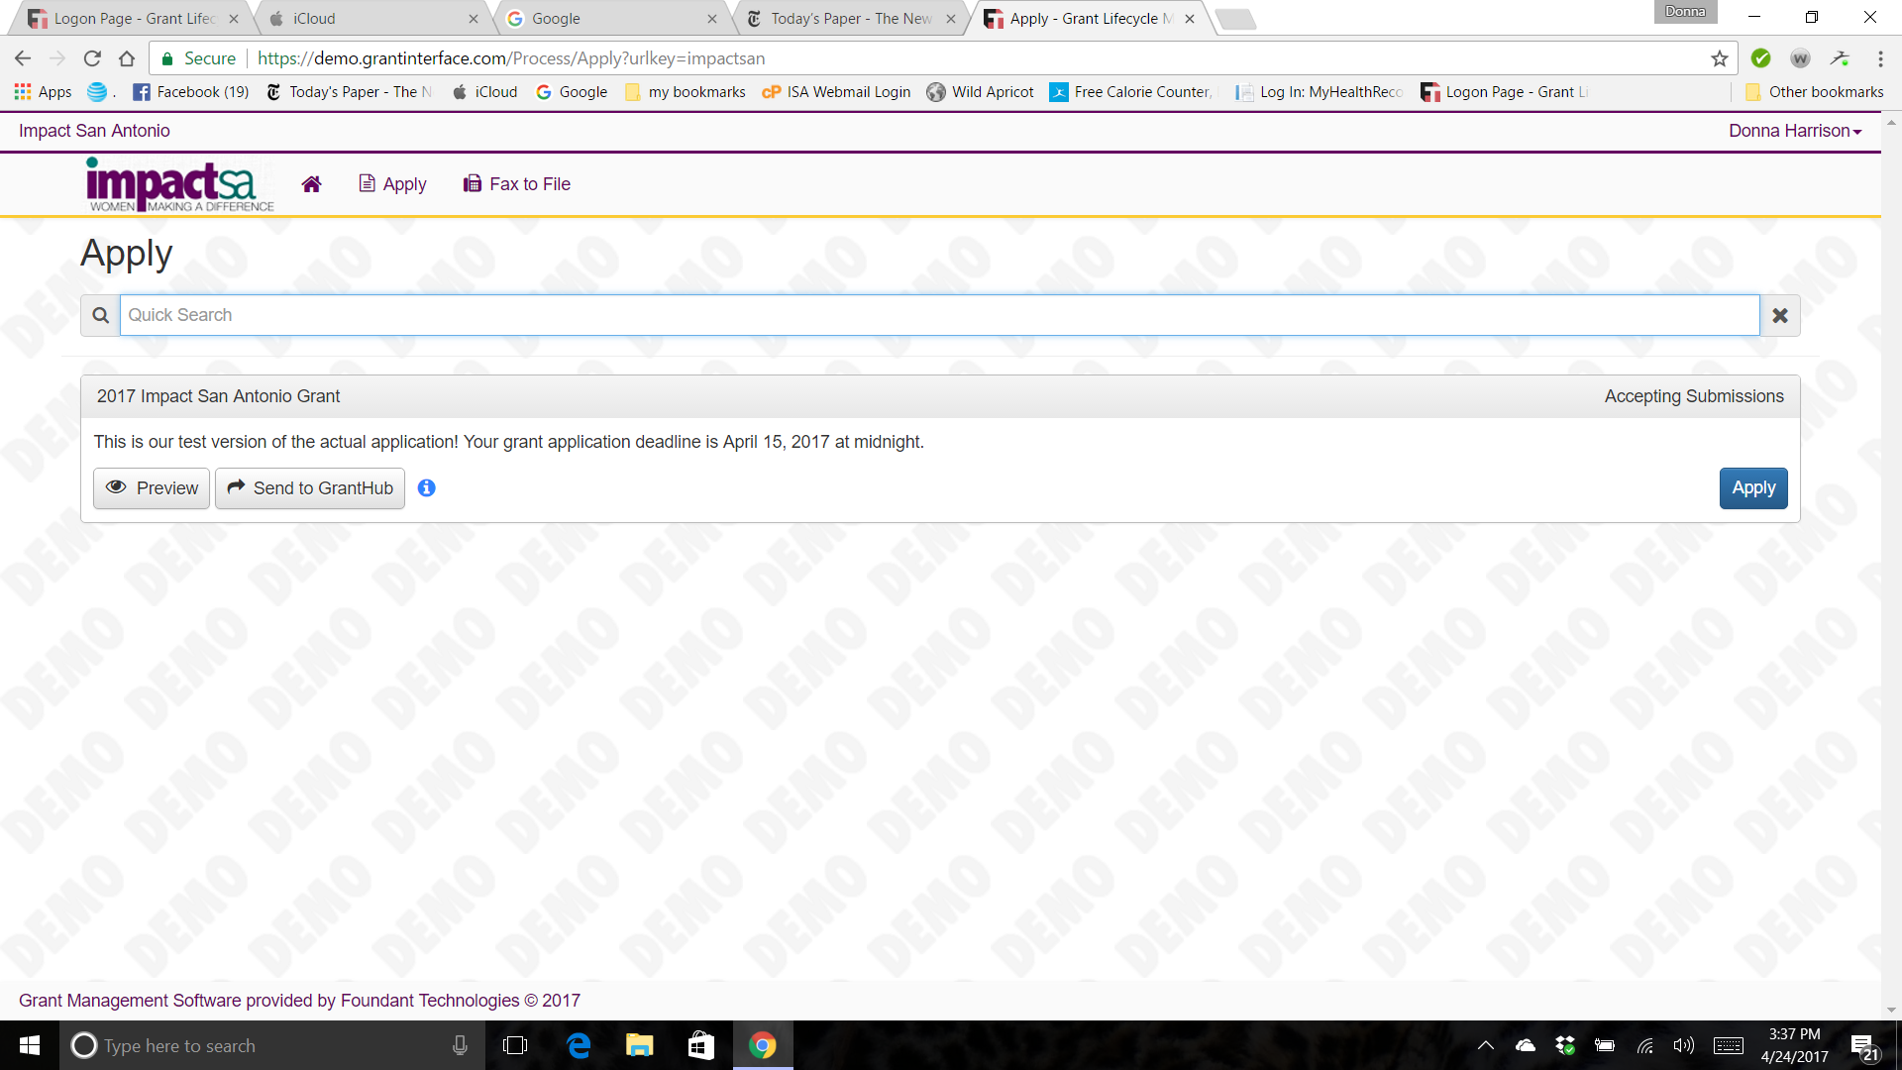
Integration with GrantHub grants management for applicants

Slide 11
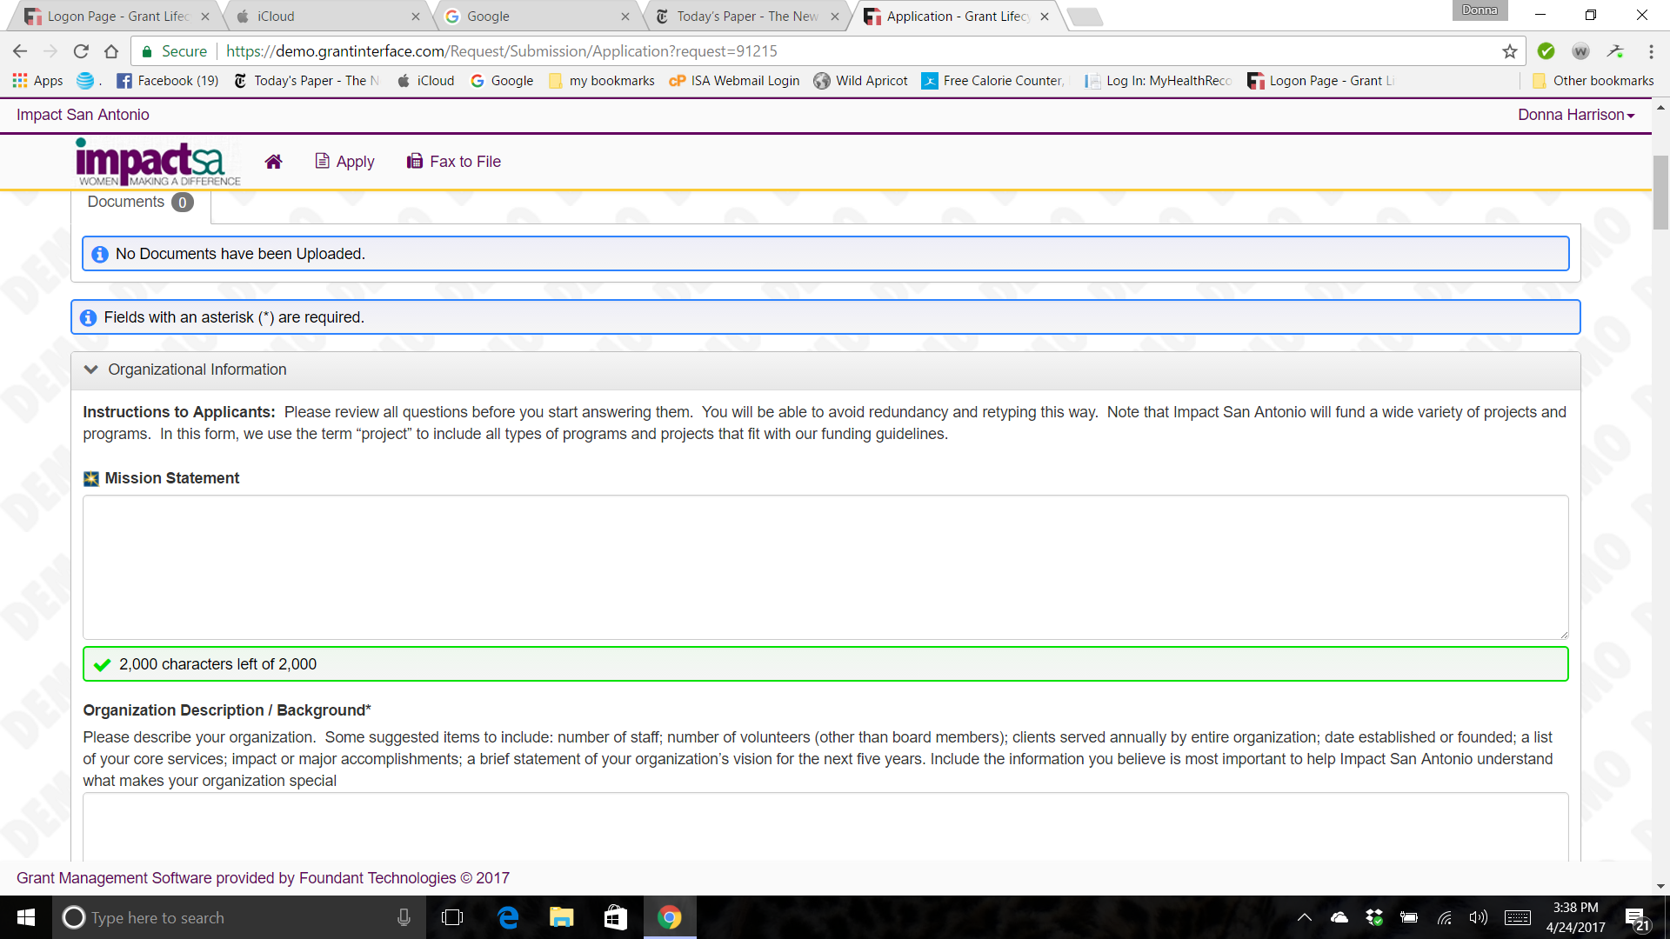
Integration with Guidestar

Slide 12
The Grant Application, Review, and Award Timeline
Impact Agency and App Teams Invite, Train, Support Agency
Tech Review
Impact Review Teams conduct Quality Reviews
Site Visits & Finalists
Agencies Plan, Write & Submit Grant Requests
GAN
May 8 - June 9
June 15-30
July – Sept
October 25
19

Slide 13
Writing an Impactful Grant Application

Slide 14
Tell Us About Your Agency
Organization
Give a brief description of your organization
Who do you serve?
What makes your organization unique/special?

Slide 15
Tell Us About Your Project
What critical and specific need does your project address?
Who does it serve?
How does it improve the quality of life for individuals served?
Does it fit with and advance the mission of your organization?
Is it consistent with the funding priorities of Impact San Antonio?

Slide 16
Tell Us About Your Project
How does this project fit with the selected focus area?
Is it a new project?
Is it an expansion of an existing project?
Is it a capital improvement project?
Do you rent or own the facility?

Slide 17
What Impact Does Fund? What can be in your proposed budget?
The budget for which funding is requested can include all of the direct costs of the project (personnel, equipment, supplies, etc.)
No more than 10% of the awarded amount may be used for agency overhead, i.e., rent for existing facility, insurance, utilities, etc.

Slide 18
What Impact Does Not Fund
Partisan or legislative activities and political lobbying,
Bridge or interim financing
Religious proselytizing
Endowments and Scholarships
Funding of ongoing operating expenses

Slide 19
An Impactful Grant Application is:
Compliant
Concise
Compelling

Slide 20
Compliance
Must be serving and present in one of the following counties: Atascosa, Bandera, Bexar, Comal, Guadalupe, Kendall, Medina and Wilson
Must be a 501(c) 3
Must be completed in two years
Must identify with one Primary Focus Area. Does your project relate to other focus areas?
Will fund a new project
Will fund expansion/improvement of an existing project

Slide 21
Eight Required Documents
Project Budget
Current Organizational Budget
Historical Financial Statements
Most Recent Audited Financial Statements
IRS Determination Letter
Organizational Chart
List of Board Members
MOUs or Letters of Commitment From Any Agency Collaborating on the Proposed Project

Slide 22
Concise
Be Concise:
Succinctly tell your story.
Avoid redundancy – Remember reviewers have 10 – 40 applications to read.
Avoid generalizations – State your case with specificity using evidence where possible.

Slide 23
Compelling Markers of High Impact Grants
A high impact grant will address a critical need in one or more of the five focus areas.
A high impact grant will improve the quality of life for people in Bexar County and/or the contiguous counties.
A high impact grant will either benefit a large population or a small population in a major way.
A high impact grant will result in an innovative approach to address a critical problem or will expand upon an already existing successful approach.
A high impact grant will support a comprehensive and holistic approach to the problem being addressed.
A high impact grant will result in compelling and measurable outcomes.

Slide 24
Financial Documentation

Slide 25
Financial Review Guidelines
Liquidity
Sufficiency of Reserves
Balance between Program, Management and Fundraising Expenses
Sustainability of Revenue Streams
Consistency

Slide 26
Project Sustainability
Does the project require additional funding beyond the grant?
How will the project be supported in the future?
What challenges do you see in implementation of this project?
What is the plan for addressing any challenges?

Slide 27
Files to Upload, in Review:
Org Chart
IRS Determination Letter
Most Recent Audited Financial Statements
Historical Financial Information *
Current Organizational Budget *
MOUs or Letters of Commitment
Project Budget *
List of Board members *
* Required Impact San Antonio Template
Your agency will NOT pass Technical Review if submitted in another format.
Other financial information: Project Budget Narrative

Slide 28
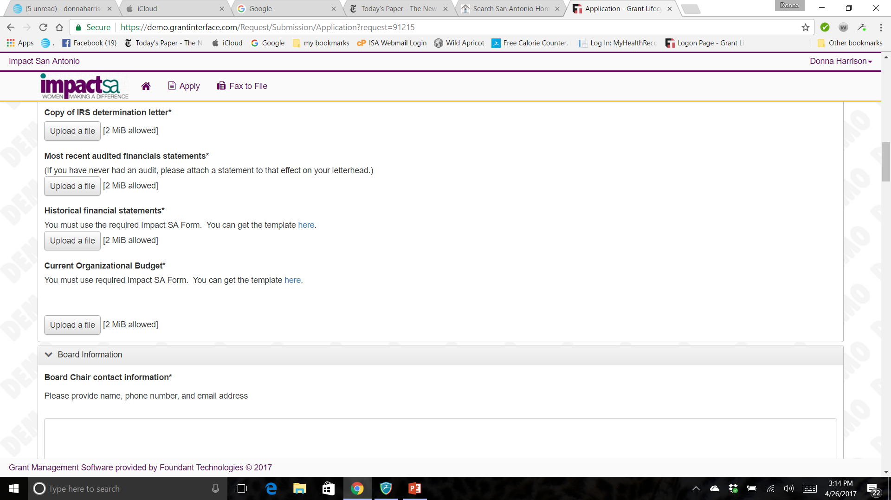
Downloading the Files
⬇
➔
Click on the link to download the standardized form

Slide 29
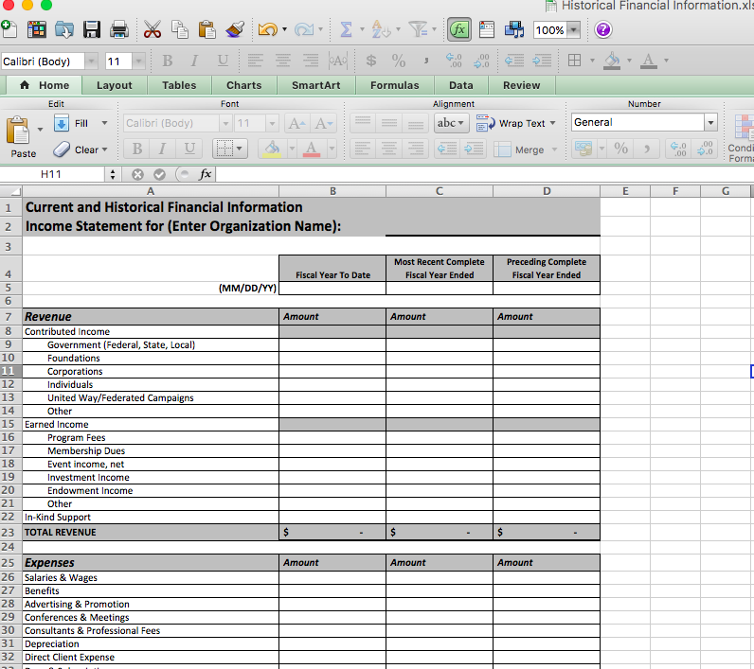
Downloaded Excel Document

Slide 30
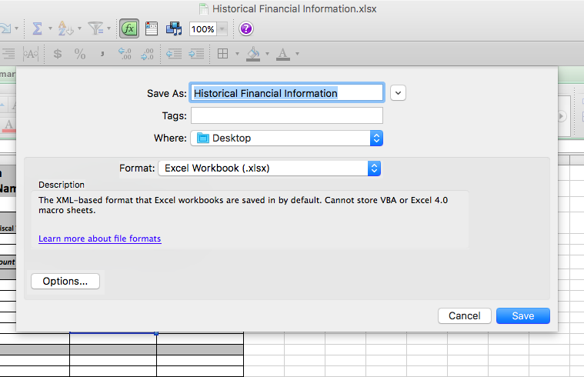
Save to Desktop/Grant Files

Slide 31
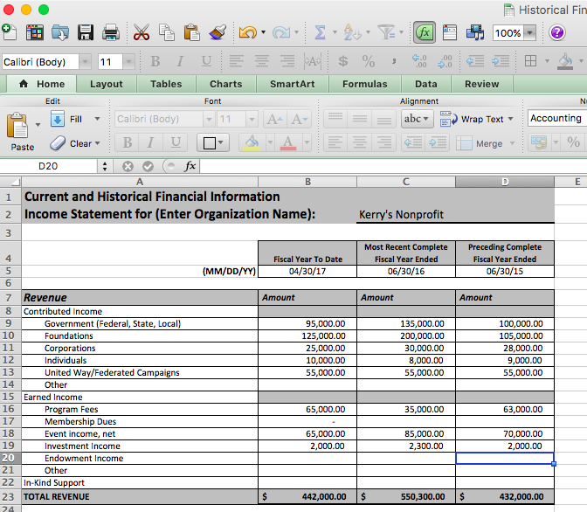
Complete & Save
⬇
⬅

Slide 32
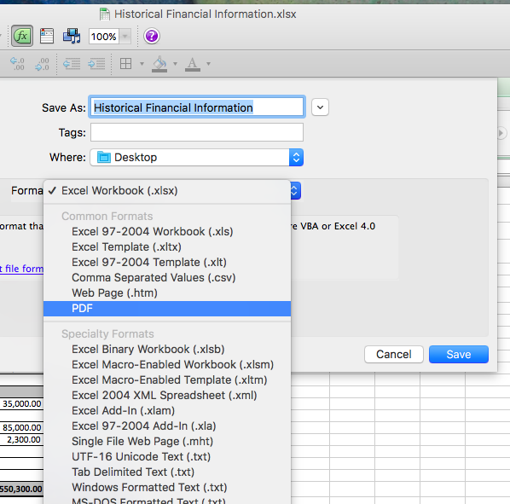
Save as PDF, if desired

Slide 33
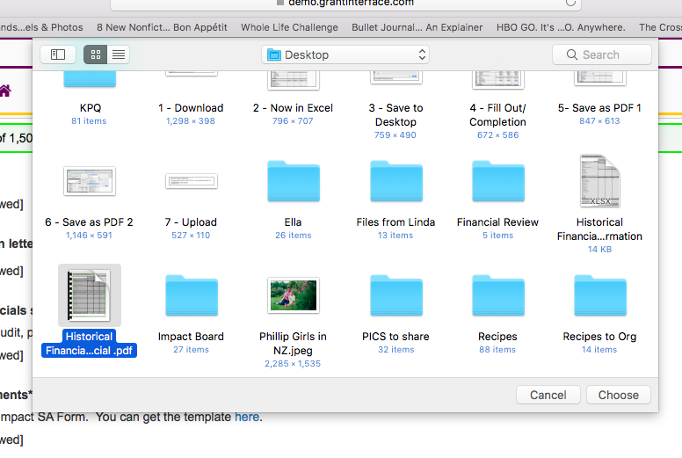
Upload File
➔
➔

Slide 34
… and done!
➔
Detail is essential in your Project Budget Narrative!
Questions? treasurer@impactsanantonio.org

Slide 35
IMPACT SA
APPLICATION
REVIEW
PROCESS
Technical Review of Apps
Table/Consider
Deep Dive Reviews
Site Visit
Finalist Selection
GRANT AWARD NIGHT
Notes:
Sometimes helps to look at this as a process outside of your primary scope in the context of what happens before you receive the applications and how the fruits of work are the finalists that the entire membership consider on grant award night. We’ll go through each one in more detail.

Slide 36
“Typical” timeline for a Grant Review Committee
IMPACT SA
APPLICATION
REVIEW
PROCESS
June 15-30
Technical Review of Apps
Table/Consider
Early to late July
Deep Dive Reviews
July or August
Site Visit
August
Finalist Selection
By September 18
GRANT AWARD NIGHT
October 25
Notes:
Sometimes helps to look at this as a process outside of your primary scope in the context of what happens before you receive the applications and how the fruits of work are the finalists that the entire membership consider on grant award night. We’ll go through each one in more detail.

Slide 37
Strengthening Your Application
(aka Helpful Hints)
• Project funding request of exactly $100,000.
• Demonstrate how this is a mission critical project and not
simply a perk.
• Read all questions carefully and provide specific answers.
• Be very specific about how Impact’s funds will be used and how project goals will be achieved with those funds.

Slide 38
Strengthening Your Application
(aka Helpful Hints)
• If your application to Impact SA is part of a larger capital
campaign, specify how our funds are mission critical or a core
piece of the project.
• If your application to Impact SA is part of a larger project, be
very clear how the bulk of the other funds to support this
project are already secured or have a convincing expectation
of being acquired in the near future.
•Project funds should directly correlate to implementing or
expanding services in the counties served.

Slide 39
Strengthening Your Application
(aka Helpful Hints)
• Primary outcomes are clearly identified, articulated and
measurable.
• Agency should be well prepared for the site visit which is
intended to gain knowledge about not only the agency but
the project in the application.
• Appropriate people should be available at the site visit to
communicate the project features and outcomes and answer
any further questions.

Slide 40
Outcomes – It’s About Results
A measurable impact of the project on the lives of those served by the agency

Slide 41
Grant Oversight and Outcomes
Grant Award Night
Finalists present their project to ISA members
Members vote which agencies will receive $100,000 grants
Impact grant recipients each will receive $100,000
Finalists who do not receive Impact grants will share balance of grant funds
Support grants less than $10,000, or
Support grants of $10,000 or more

Slide 42
Grant Oversight and Outcomes
One Week After GAN
Support grant recipients <$10,000 will be asked how they will spend the money and they will receive a lump sum check
Support grant recipients > $10,000
Will be asked to prepare a revised project description and budget
Will be subject to the same terms and conditions as Impact grant recipients

Slide 43
Grant Oversight and Outcomes
Official Award Notice
Contracts between ISA and grant recipients will be signed approximately six weeks after GAN
Financial Administration
Reporting Requirements
Contract specifies two-year award period
Chair of Grant Oversight and Outcomes will meet with each agency and their assigned liaison

Slide 44
Grant Oversight and Outcomes
Financial Administration
Payments are made on cost reimbursement basis
Liaisons work with agency point-of-contact to process reimbursement requests
Reporting Requirements
Progress reports (every six months)
Final report (within thirty days of project completion)

Slide 45
Grant Oversight and Outcomes
Outcomes Reports due one and two years post project completion
Now that some time has elapsed, please explain how your clients’ lives were actually affected.
Has the project had a ripple effect on others, i.e. multi-generations, family, volunteers, staff, community? In what way?
What measurement tools were you able to use to determine outcomes? Are these the same tools you proposed in your original application?
Will you continue collecting data regarding the outcomes of this project? If so, how will that information be used?
How have you notified your clients and the community that Impact San Antonio provided funding to help support this project?

Slide 46
Resources
www.impactsanantonio.org
How to Apply for Funds link
FAQs link
Email: grantinfo@impactsanantonio.org
www.guidestar.org

Slide 47
Contact Information
Agencies and Applications Co-Chairs
For general questions about the application process contact:
Cathy Foose grantinfo@impactsanantonio.org
Kim Gilbert
grantinfo@impactsanantonio.org
Treasurer and Chair –Financial Review
For questions about the financial documentation contact:
Kerry Quinn
treasurer@impactsanantonio.org

